Slide 1



The Knapsack problem – 0-1 and continuous
Input: n objects, each having an associated cost (occupied capacity) and a value (the gain obtained by choosing that object))
i=1,..,n (0,..,n-1) objects;$c_{i}$-cost, $v_{i}$ - value
Cmax – maximum cost (maximum capacity)
Knapsack problem 0-1 – determine a subset – so that the selected objects do not exceed Cmax and the total value of the selection is maximized
Representation
0-1 Case
Genotype – $s=\left(s_{1},s_{2},…,s_{n}\right)$, $1≤i≤n, s_{i}$ $∈${0,1};
- $s$ is a candidate solution (feasible solution)
$$cost\left(s\right)=\sum_{i=1}^{n}{s_{i}∙c_{i}}≤Cmax$$
The problem is to be modelled with constraints
GA solution space (genotype space): ${\left\{0,1\right\}}^{n}$ with cost(s)$≤$Cmax
?

Slide 2


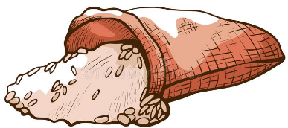


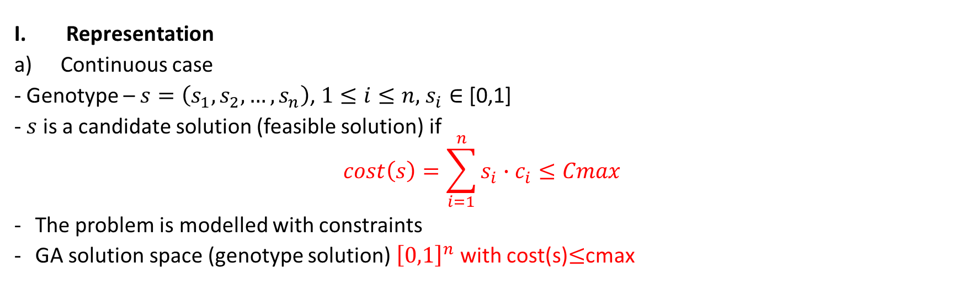
The Knapsack problem – 0-1 and continuous
2. For each object, compute the selected fraction such that the maximum capacity is not exceeded and the selection has maximum value.
Hypothesis: costs and values are equally distributed for each object: If one item has cost 10 and I choose 0.1 of it, the cost of the selection is 1.
%?
%?
%?
%?
Representation
Continuous case
- Genotype – $s=\left(s_{1},s_{2},…,s_{n}\right)$, $1≤i≤n,$ $s_{i}∈$ [0,1]
- $s$ is a candidate solution (feasible solution) if
$$cost\left(s\right)=\sum_{i=1}^{n}{s_{i}∙c_{i}}≤Cmax$$
The problem is modelled with constraints
GA solution space (genotype solution) ${\left[0,1\right]}^{n}$ with cost(s)$≤$cmax

Slide 3

The Knapsack problem – 0-1 and continuous
II. Fitness function
$$fitness\left(s\right)=\sum_{i=1}^{n}{s_{i}∙v_{i}}$$
III. Population model
Populations with constant size over time
Generational model
IV. Initial population – random, such that each individual has the same probability of being generated

Slide 4
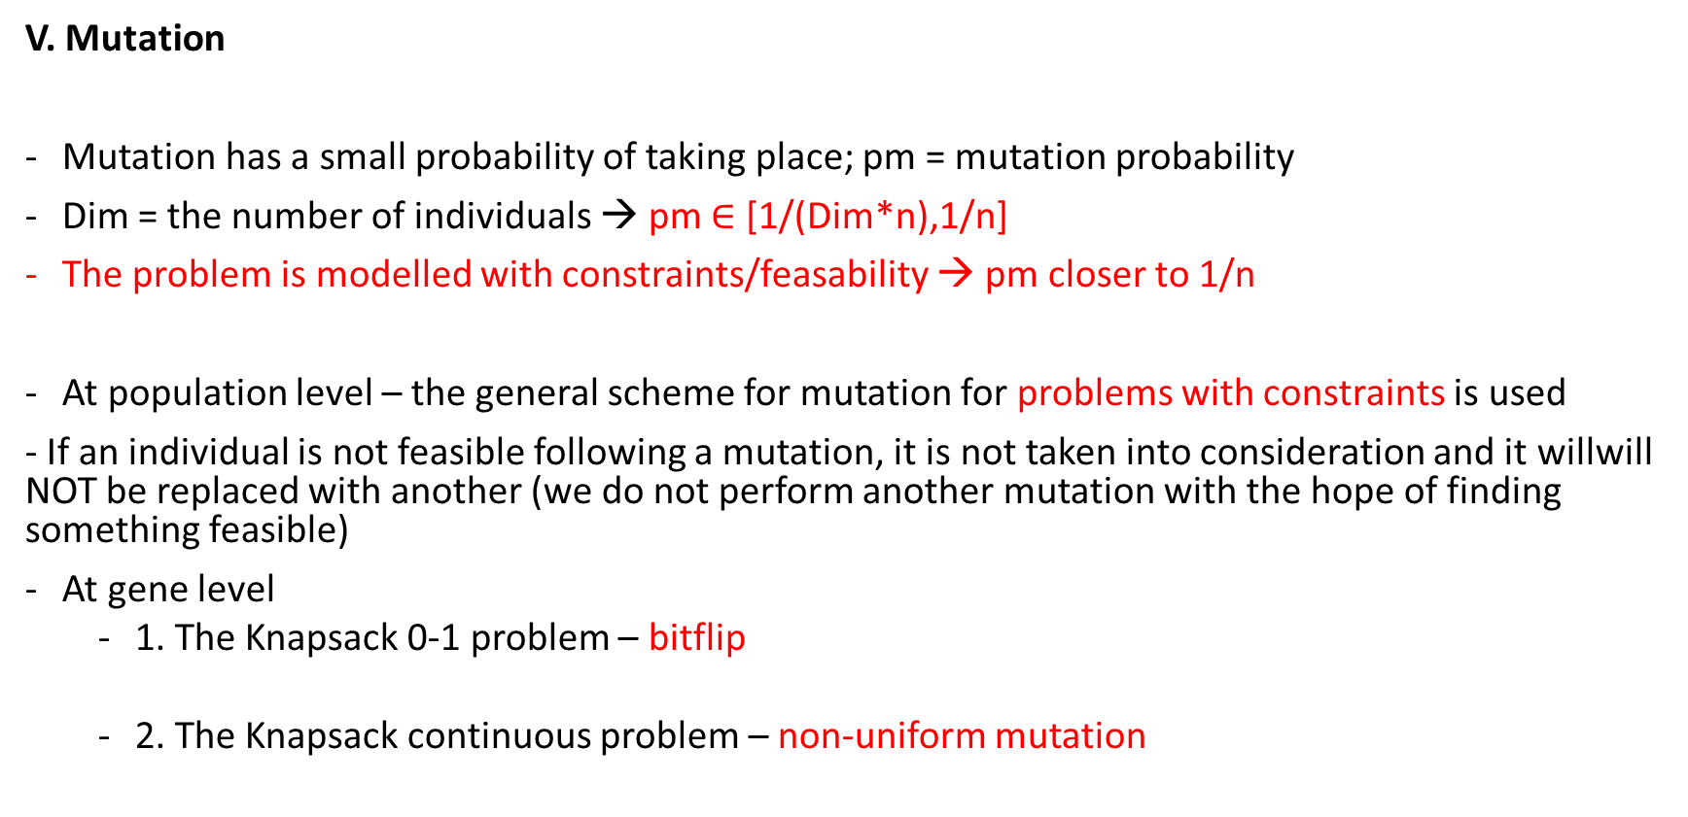
The Knapsack problem – 0-1 and continuous
V. Mutation
Mutation has a small probability of taking place; pm = mutation probability
Dim = the number of individuals → pm $∈$ [1/(Dim*n),1/n]
The problem is modelled with constraints/feasability → pm closer to 1/n
At population level – the general scheme for mutation for problems with constraints is used
- If an individual is not feasible following a mutation, it is not taken into consideration and it willwill NOT be replaced with another (we do not perform another mutation with the hope of finding something feasible)
At gene level
1. The Knapsack 0-1 problem – bitflip
2. The Knapsack continuous problem – non-uniform mutation

Slide 5
The Knapsack problem – 0-1 and continuous
VI. Crossover
With high probability; pc = probability of crossover ( 0.6,0.7…)
Generational model → the generation of dim descendants must be ensured
The problem has constraints → not all descendants are feasible
If a descendant is not feasible, it is replaced with its corresponding parent
Asexual crossover is implemented
At population level – general crossover scheme for problems with constraints (if a result is not feasible, it is not taken into consideration for next steps and the parent is propagated instead)
At the parent pair level:
1. 0-1 problem – crossover uniform crossover(alternatively we can choose single-/multi-point)
2. continuous case problem – simple or simple average crossover. Choosing the total average is incorrect because the fitness function is linear

Slide 6
The Knapsack problem – 0-1 and continuous
VII. Selection of parents
Number of parents – based on the used model (dim)
Fitness score is positive → any probability of selection can be used (FPS or rank) simulated with the SUS mechanism (recommended) or roulette
Possible choices – FPS with sigma scaling and SUS/roulette;
Tournament selection– for didactic purposes
VIII. Replacement of the current population (Selection of Next Generation)
Replacement mechanism – based on the used model (generational)
All offspring (descendants) are propagated, except when the best ”old” individual (from the current generation) is better than all new individuals → elitism

Slide 7
The Knapsack problem – 0-1 and continuous
IX. Conditions for continuing the search for best solution
The number NMAX evolutive cycles (generations) has not yet been exceeded.
There are at least 2 individuals in the population that have different fitness score (otherwise the genetic variability is null)
During the last K evolutionary cycles the best quality (fitness score) has changed at least once, where K =NMAX/2

Slide 8
The Knapsack problem – 0-1 and continuous
Black Box
Problemă
Cutie neagră
Problem
Stabilire reprezentare și funcție obiectiv
Generare populație inițială
Generație curentă
Multiset părinți
Descendenți (încrucișare)
Descendenți (mutație)
Generație nouă
Rezultat
Populație finală
Soluție
Decodificare
Solution

Slide 9
The Knapsack problem – 0-1 and continuous
The Genetic Agorithm (GA):
Iteration (generation) gets assigned value of i = 0.
Initialization of population P_{i} is obtained by randomly generating the candidates to the solution
Evaluate the candidates: for each x $ε$P_{i} , determine fitness(x)
Repeat:
Select the set of parents
Perform crossover on the parents pairs (or n-tuples)
Execute mutations on the resulted offspring
Evaluate the new candidates to solution
Select the individuals to be passed on as the next generation P_{i+1}
Iteration (generation) gets assigned value of i + 1 until the Termination Conditions are met.

